Slide 1
ATMOSPHERE Dr. Shakha Sharda

Slide 2
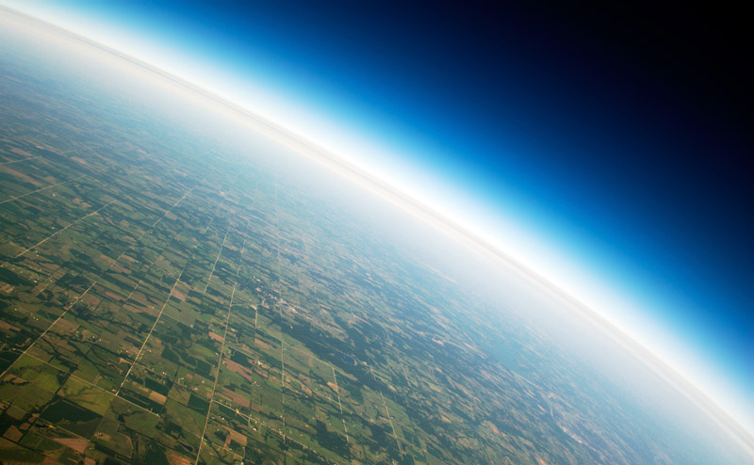
Introduction
Layer of gases surrounding the Earth
Held due to gravitational pull
Height of atmosphere from sea level is 1600 km
Derived from Greek word “atmos” means vapour
Composition of atmosphere
major : water vapours (most variable component) N; 78% (largest proportion) and O₂ ; 21%
minor : Ar; 0.9, CO₂; 0.03%
trace : Ne, He, Xe, Rn etc.

Slide 3
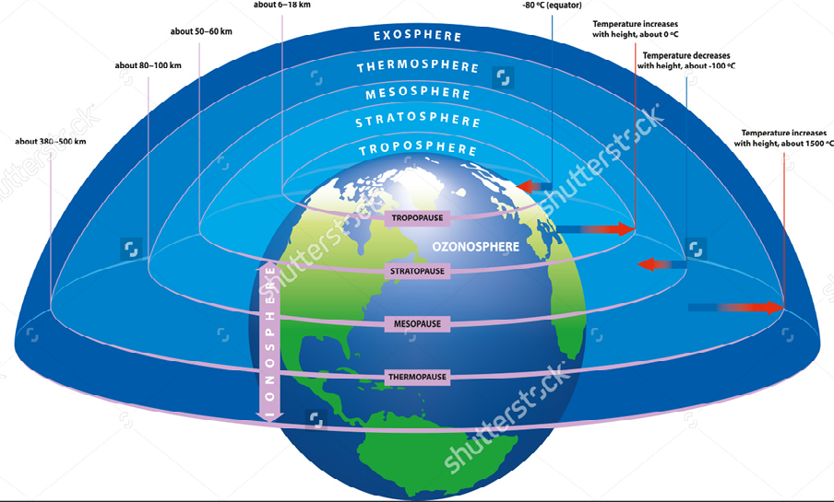
Structure of Atmosphere
(Sutcliffe : 1966)

Slide 4
Structure of Atmosphere
Troposphere
lowest layer (layer closest to man)
Greek word: tropos; mixing
distance: 8 kms from poles; 18kms from equator
temperature decreases with increasing altitude (+lapse rate)
turbulent region, climate changes, cloud formation, regulates weather, lightening, thundering , sound transmission
twilight of dusk and dawn, medium of flight
pollination of seeds, fruits, seeds and spores
Circulation of biogeochemical cycles(CO_{2,} O_{2,} H₂O, N)
Tropopause: transition zone between troposphere and stratosphere, winds move in horizontal direction (jet streams: 480kms/hr)

Slide 5
Contd---
Stratosphere
second layer: 16-55 kms
ozone layer: 25 km from mean sea level (protects from harmful UV radiations)
temperature increases with height (negative lapse rate)
no mixing: free of clouds
long distant flights
Stratopause: boundary between stratosphere and mesosphere

Slide 6
Contd---
Mesosphere
55-80 kms :middle atmosphere
temperature decreases with height
meteors burns up
coldest layer
Mesopause: boundary between mesosphere and thermosphere

Slide 7
Contd---
Thermosphere
80-500 kms.
temperature increases with height
telecommunication services
phenomenon of Auroras ( colorful light display which can be seen almost every night by people near poles)
Exosphere
Up to infinity

Slide 8
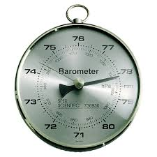
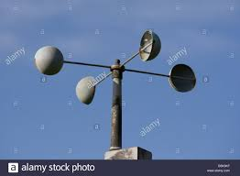
Contd---
Study of troposphere and stratosphere is called Meteorology.
Study of mesosphere and thermosphere is called Aerology
Atmospheric pressure: Barometer
Temperature : Thermometer
Wind : Anemometer
Atmospheric humidity: paper strip hygrometer

Slide 9
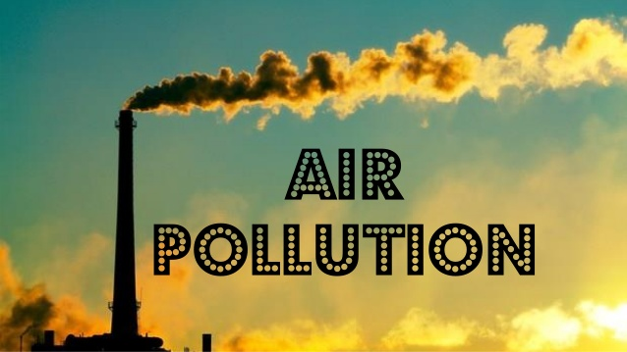

Slide 10
Air pollution
WHO (World Health Organization)
the presence of materials in air in such concentration which are harmful to man and environment is known as air pollution.
Sources
Natural: e.g. Volcanic eruptions, forest fires
Man-made: e.g.combustion, industrial processes, agricultural activities, household activities

Slide 11
Types of air pollutants
Primary pollutants
remain as such in air : CO,NO, SO₂, HC, CO_{2,} NO_{2,} SPM and CFC
Secondary pollutants
formed due to chemical reactions among primary pollutants : ozone, smog, acid rain

Slide 12
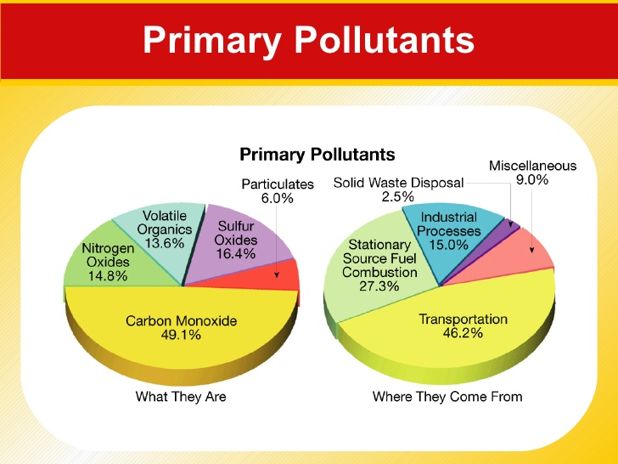
14 out of 20 most polluted cities of the world are in India and four out of these are in Punjab. NCR the most polluted region of the world where during smog each one inhales toxins equal to 30 cigarettes a day

Slide 13
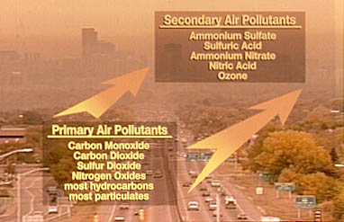

Slide 14
Oxides of carbon
CO: incomplete combustion
hypoxia : O deficiency
anoxia : CO poisoning
CO₂ : complete burning
ocean acidification
green house effect: CO₂, CH₄ N₂Oand CFC’s (Green House Gases)
global warming

Slide 15
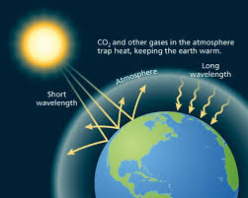
GREEN HOUSE EFFECT

Slide 16
Oxides of SO₂
Cause acid rain
Leads to chlorosis (yellowing of leaves) and necrosis ( death of tissues)
Discoloration of buildings
Irritation in eyes
Asthma
Kills fishes
Mutagenic properties

Slide 17
Oxides of NO₂
Photochemical smog
PAN (Peroxy Acyl Nitrate)
Acid rain
Corrosion of metals
Fading of textiles
Necrosis, defoliation
Eye irritation, lung odema, blood congestion
Injury to lungs, liver and kidneys

Slide 18
SPM (Suspended Particulate Matter)
Cotton dust : Bysinosis/ Pneumoconiosis
Stone grinding : Silicosis
Iron mills : Siderosis
Pollen grains : Hay fever
Others:
VOC’s ( Volatile Organic Compounds) : benzene, toluene, xylene
Carcinogenic
Leukemia

Slide 19
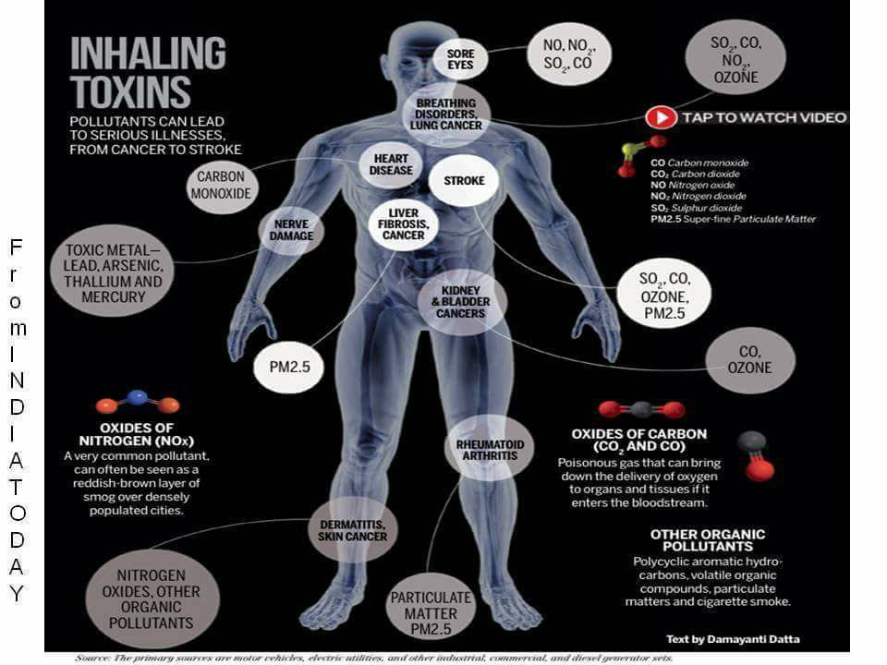

Slide 20
Secondary Pollutants
Acid rain ( Nitric acid and Sulphuric Acid)
term coined by Robert Angus Smith, 1872
pH less than 5.4 (Acid Rain)
West Virginia, Washington D.C. : pH 1.2
Taj Mahal (India)
Dead lakes (Norway, Sweden, Germany, U.S.A.)
Stone leprosy

Slide 21
Photochemical Smog (fog+smoke)
1946 (Los Angeles, U.S.A.)
Brown haze
Automobiles exhaust
NO₂
PAN (Peroxy Acyl Nitrate)

Slide 22
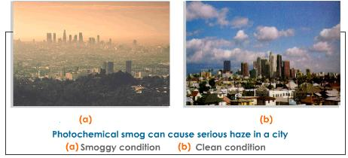

Slide 23
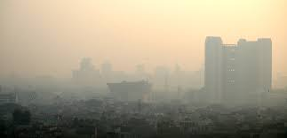
Reducing Smog/ Classical smog
1952 (London)
Blackish grey
Burning of coal
SO₂
Killed 4000 people in London

Slide 24
Ozone Hole/ Depletion of Ozone layer
Thinning of ozone layer (Farman et al, 1985)
Formed by the interaction of sunlight with NO_{x (}oxides of Nitrogen) and VOC’s (Volatile Organic Compounds)
Maximum thinning of ozone layer is during spring season
The thickness of ozone is measured in Dobson Unit (DU); 1DU = 1ppb
Major hole was seen over Antarctica (South Pole) and minor hole over Greenland (North Pole); September 2003.

Slide 25
Case studies
Bhopal Gas Tragedy, 3rd Dec, 1984
MiC (Methyl Isocyanate) and Phosgene
Chernobyl Nuclear Disaster, 1986;USSR
Sevoso Episode, 1976;Italy
Three Mile Island Nuclear Disaster, 1979; U.S.A
Hiroshima and Nagasaki (1945) during World War II

Slide 26
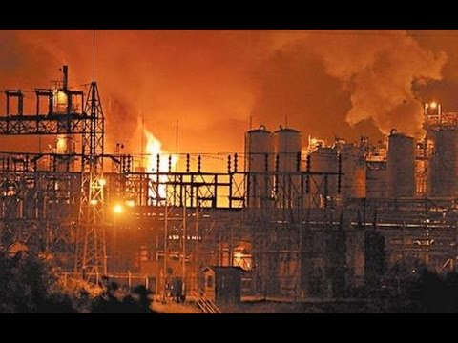
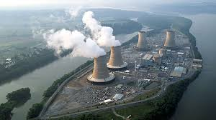
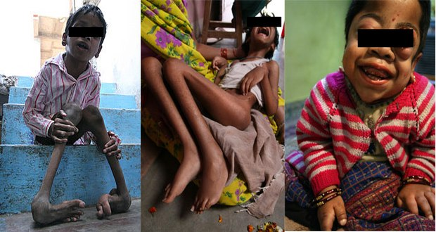
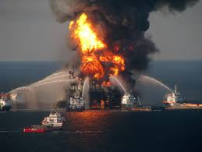
Bhopal Gas tragedy
Three mile island

Slide 27
CONTROL OF AIR POLLUTION
Control of Particulate Emissions
Gravity settlers: settling of SPM with force of gravity
Cyclone Separators: separation of particulates through centrifugal motion from a gas stream
Impinger: consists of bubble tubes for collecting particulates into a liquid medium
Wet Scrubbers: collecting the particulates in a scrubbing liquid
Electrostatic Precipitator (ESP): use an electrostatic field o induce a charge on particulates to remove them
Bag Filters: large sized porous bags for filtering the particulates under pressure.

Slide 28
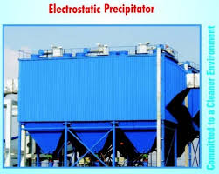
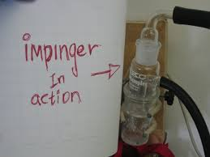
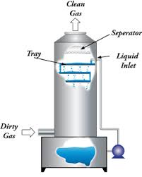
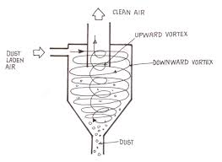

Slide 29
Control of Air Pollution
Control of Gaseous /Industrial Emissions
Tall Chimneys
Absorption(within the surface)
Adsorption (on the surface)
Condensers
Desulphurization
Raprenox (Rapid Removal of NO_{X} )
Catalytic Converters
Incinerators
Control of Vehicular Emissions
Catalytic converters
Unleaded petrol
Use of CNG
Biodiesel (Jatropa)

